Slide 1
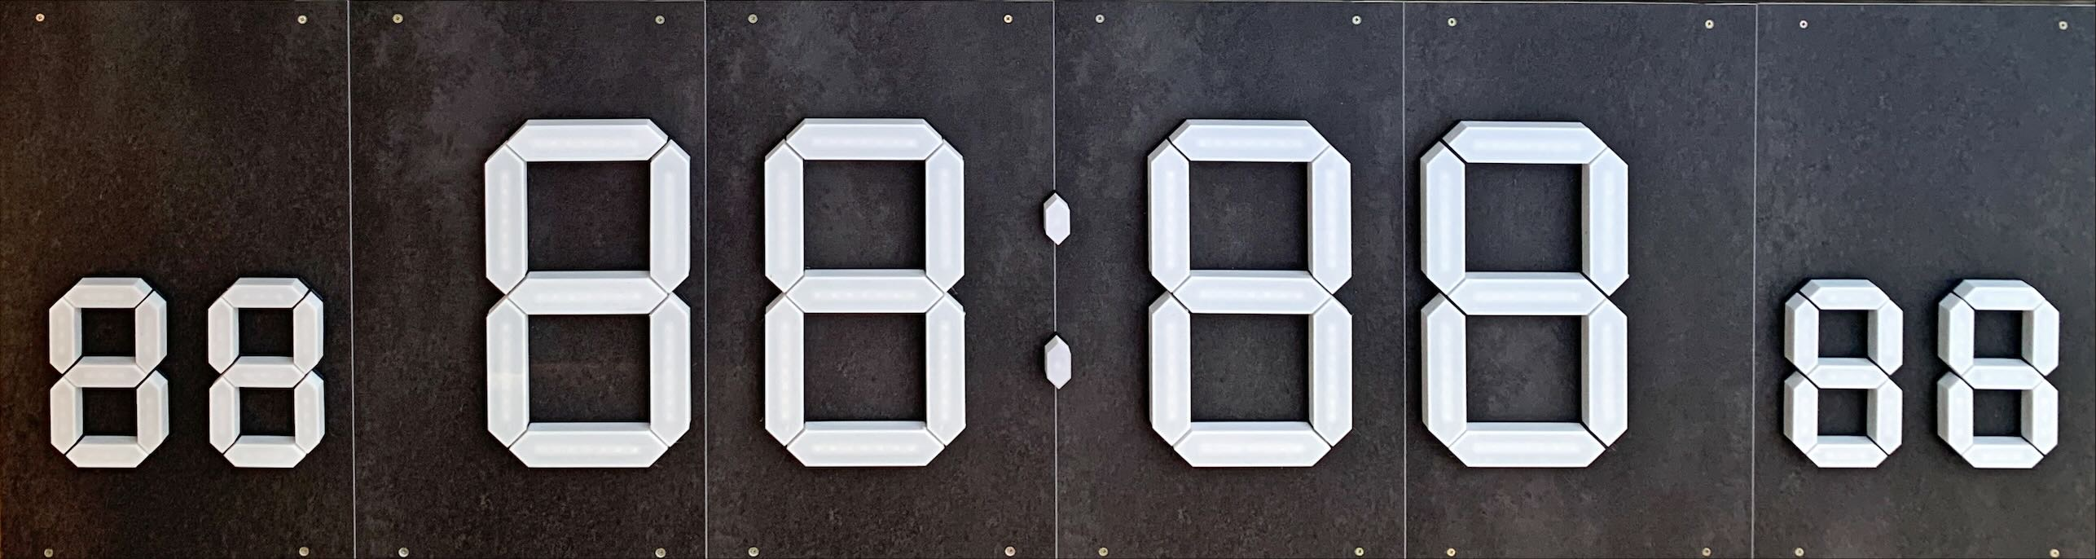
Pool Clock
Swimming pool clock - © 2023 Yves Gaignard

Slide 2
Pool Clock : Fusion 360 model representation
Air temperature
Hours of time or timer
Separation Dot
Minutes of time or timer
Water temperature
Pool Clock © Yves Gaignard - 2023

Slide 3
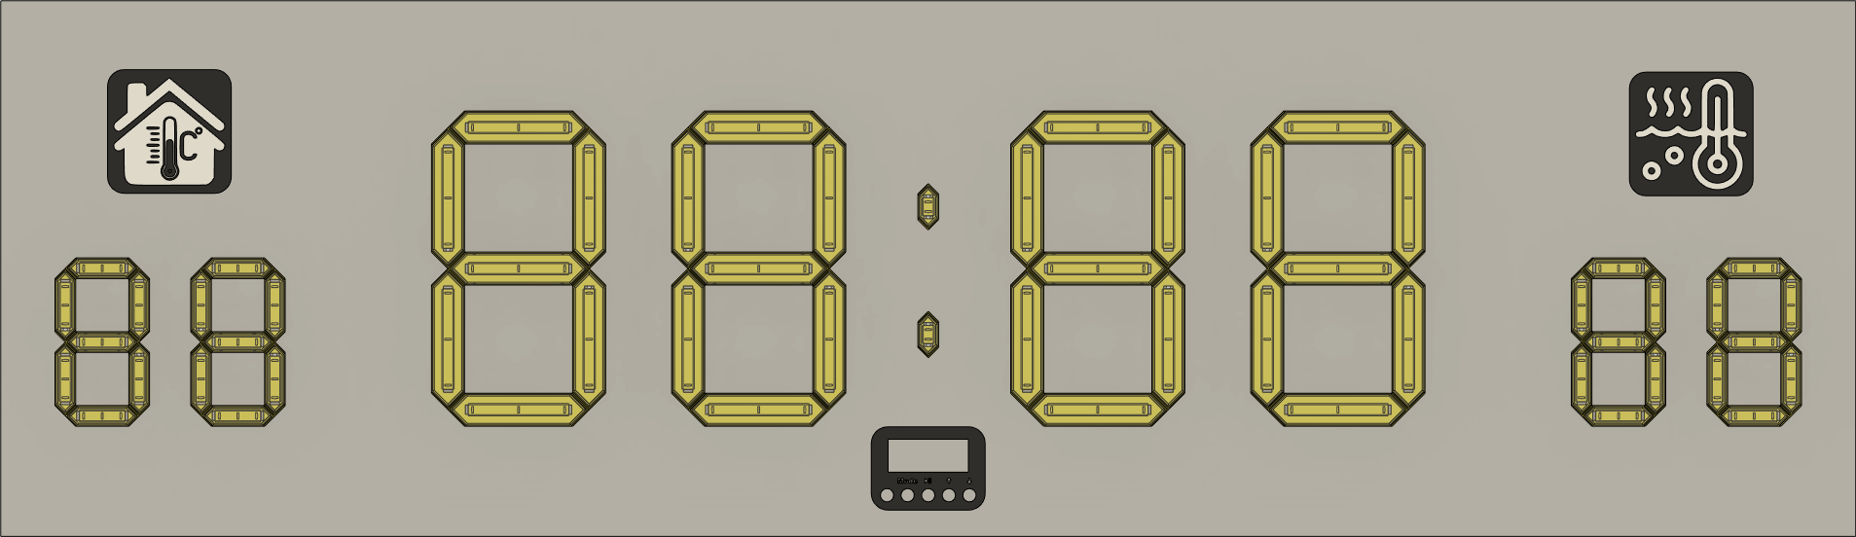
Pool Clock : Fusion 360 model representation
Air temperature
Hours of time or timer
Separation Dot & Command Display
Minutes of time or timer
Water temperature
Pool Clock © Yves Gaignard - 2023

Slide 4
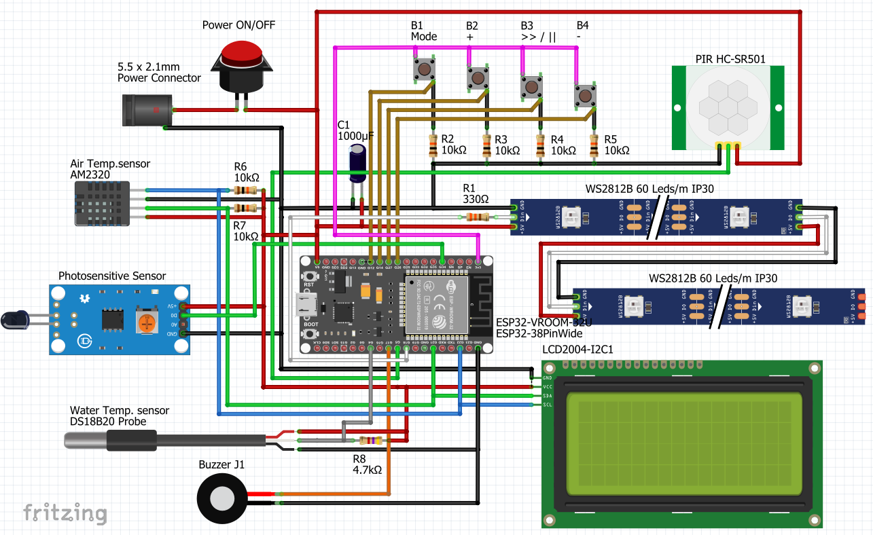
Pool Clock : Wiring Diagram
Pool Clock © Yves Gaignard - 2023

Slide 5
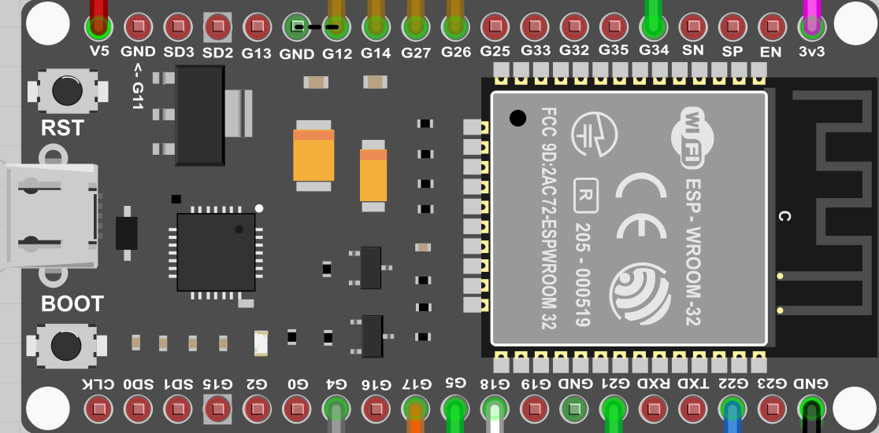
Pool Clock : Wiring Diagram
B4 -
B3 > / ||
B2 +
Light Sensor
5V
B1 Mode
3.3V
19
18
17
16
15
14
13
12
11
10
09
08
07
06
05
04
03
02
01
20
21
22
23
24
25
26
27
28
29
30
31
32
33
34
35
36
37
38
Water T°
Buzzer
SDA
SCL
PIR
LED
GND
Pool Clock © Yves Gaignard - 2023

Slide 6
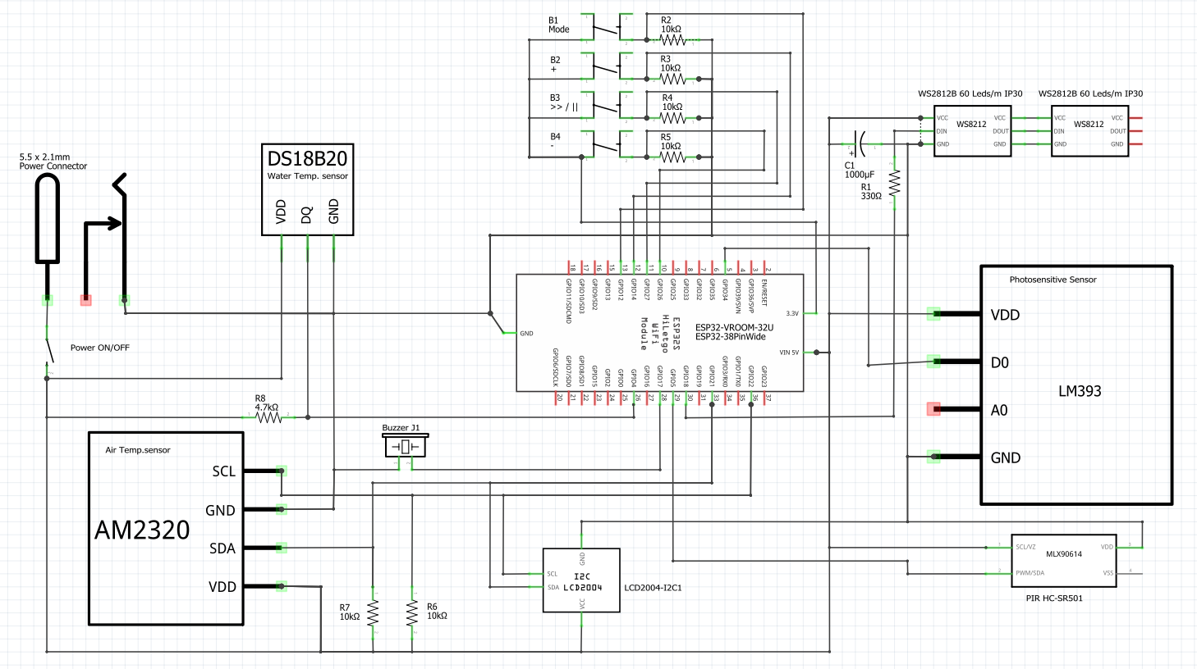
Pool Clock : Wiring schematic
Pool Clock © Yves Gaignard - 2023

Slide 7
Pool Clock : Bill of Material
Parts | Number | Description
ESP32-VROOM-32U | 1 | Micro-controller
ESP32 Breakout Board | 1 | Board adapter for ESP32 38 pins
WS2812B Led strip (5m / 60 / IP30) | 5 m | DC5V WS2812B Individually Addressable 5050 RGB Led Strip - IP30 - 60 Leds/m
Photo sensitive sensor | 1 | Photosensitive sensor module
AM2320 Temperature sensor | 1 | AM2320 Digital Temperature and Humidity
DS18B20 Waterproof Temp Sensor | 1 | DS18B20 Waterproof Temperature Sensor
LCD 20x4 I2C | 1 | LCD2004+I2C screen HD44780 Character LCD /w I2C Serial interface adapter module
PIR Motion Sensor | 1 | HC-SR501 Adjust IR Pyroelectric Infrared PIR Motion Sensor Detector
Push button | 1 | 16mm metal push button switch Waterproof Flat circular button LED light self-reset
Capacitor | 1 | 1000μF
Resistor | 8 | 1x330Ω, 1x4.7kΩ, 6x10kΩ resistors
On/off button | 1 | 16mm metal On / off Button
Piezo Electronic Buzzer | 1 | SFM-20B DC3-24V Durable 3-24V Piezo Electronic Buzzer Alarm 95DB Continuous Sound Beeper
DC Connectors 5.5x2.1mm | 1 | DC Connectors 5.5x2.1mm
LED Power Adapter AV-DC 5V/10A | 1 | LED Power Adapter 5.5*2.1~2.5mm Female Connector AC 220V To DC 5V (10A)
Pool Clock © Yves Gaignard - 2023

Slide 8
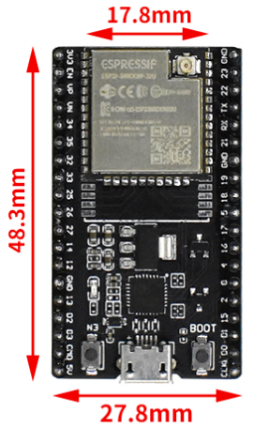
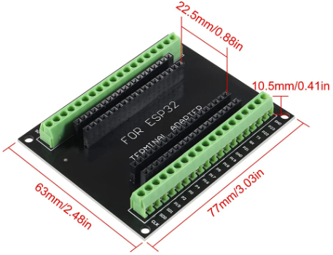
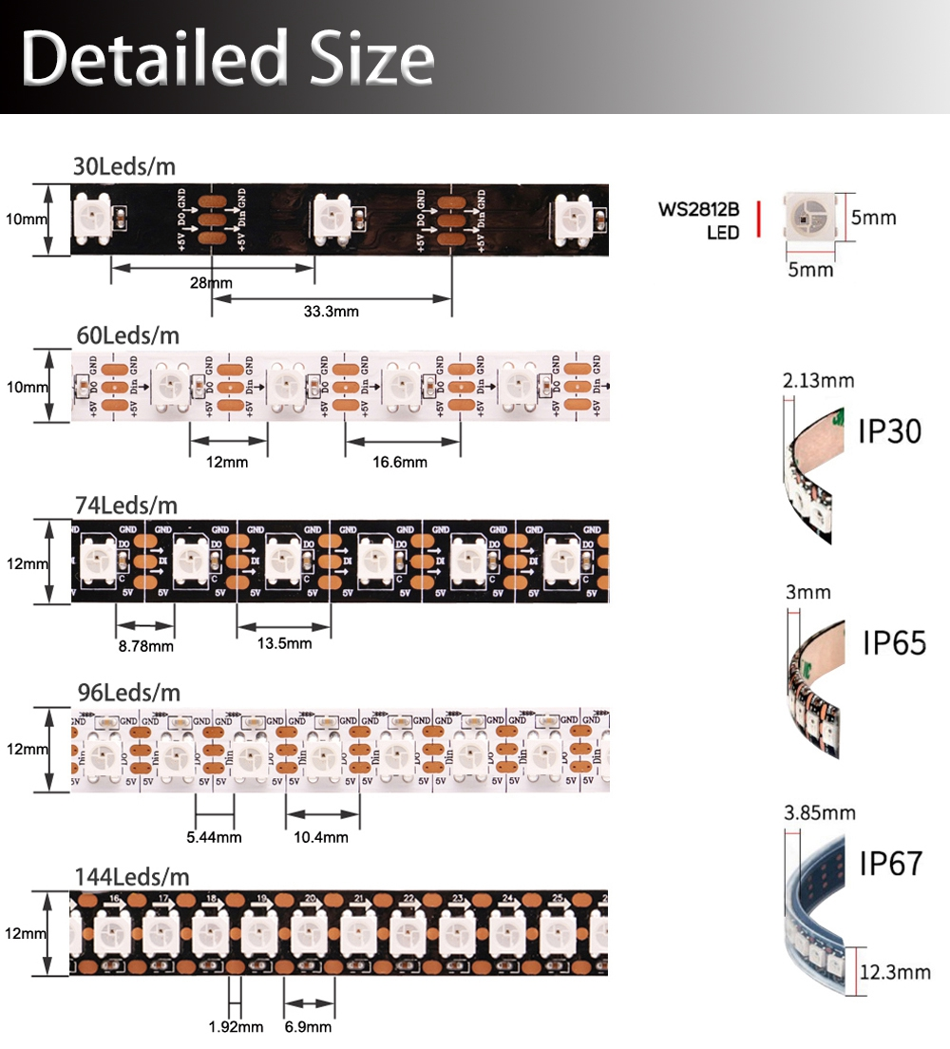
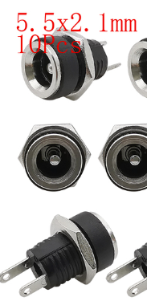
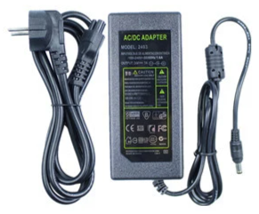
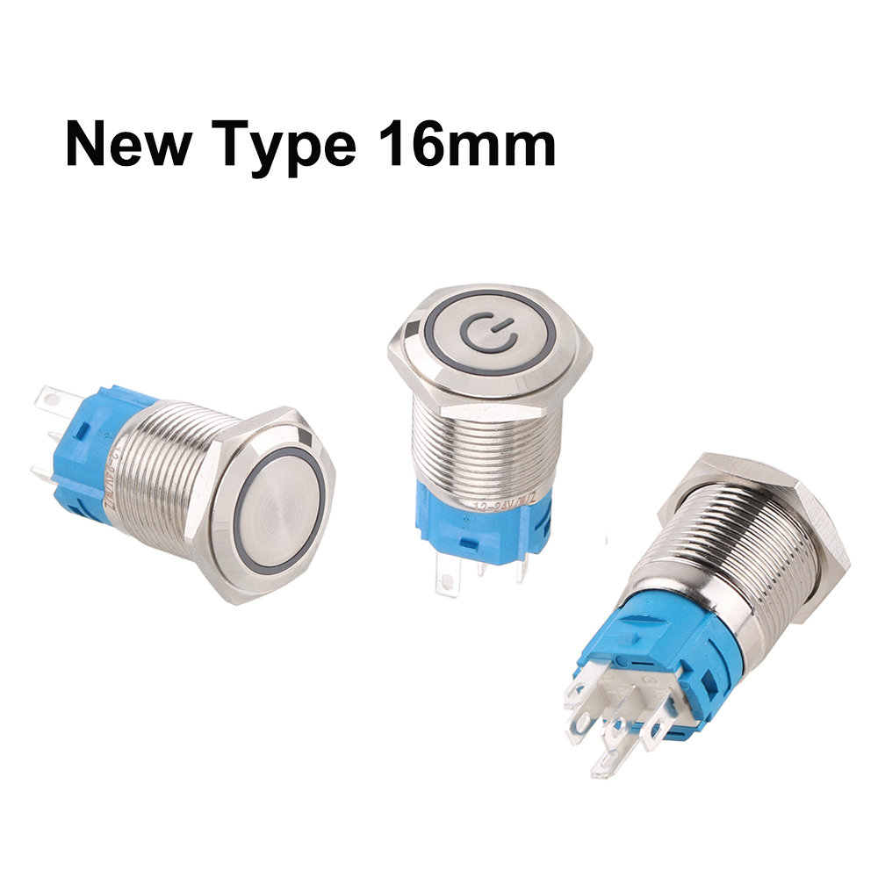
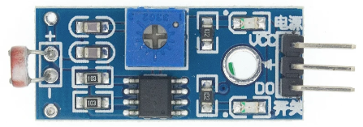
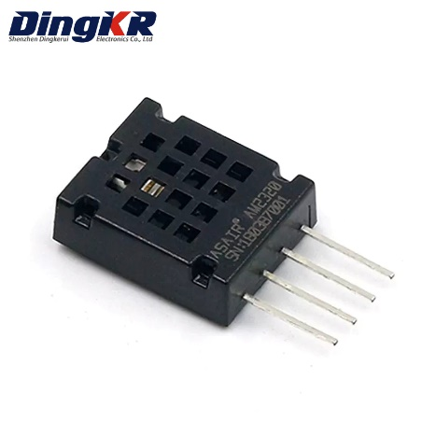
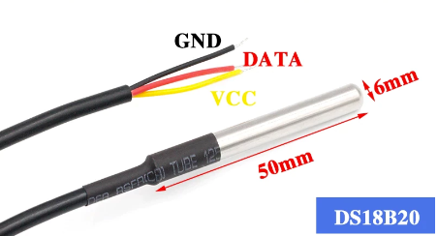
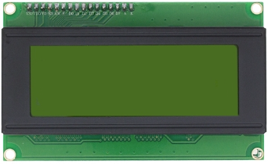
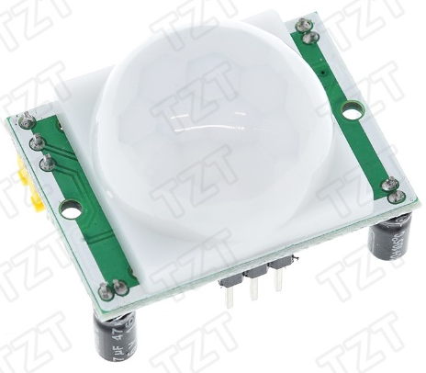
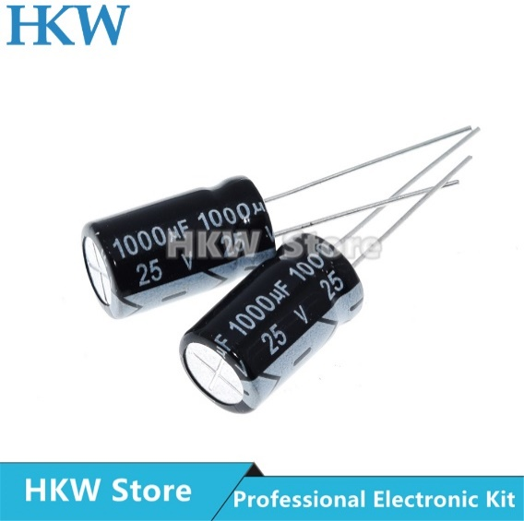
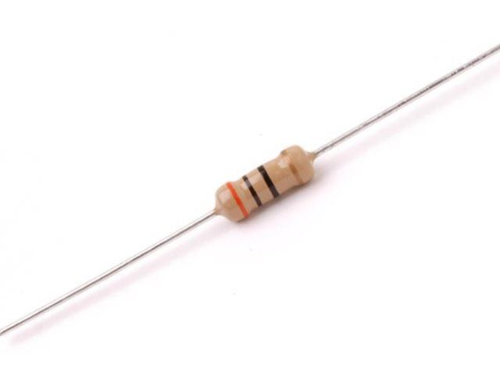
Pool Clock : Bill of Material
Pool Clock © Yves Gaignard - 2023

Slide 9
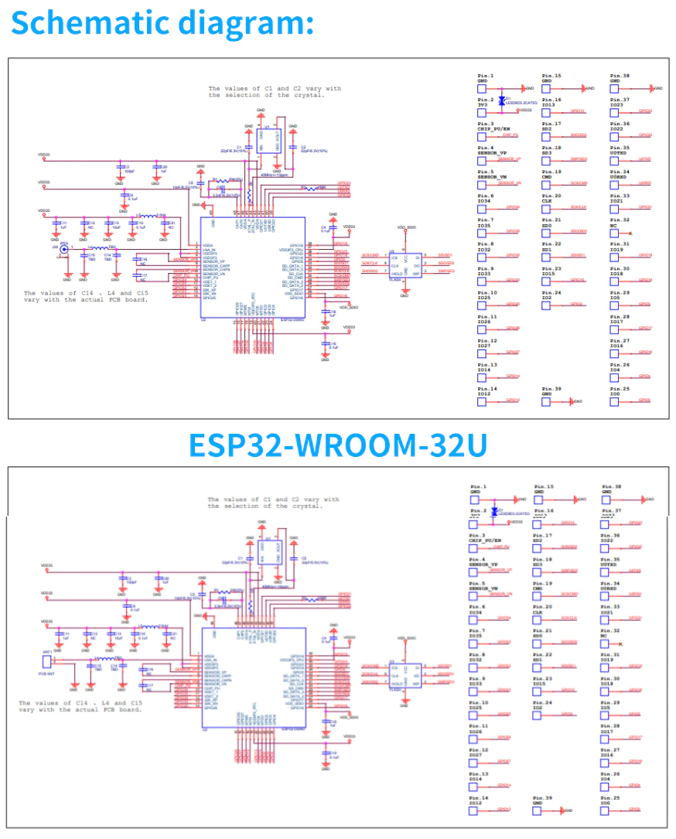
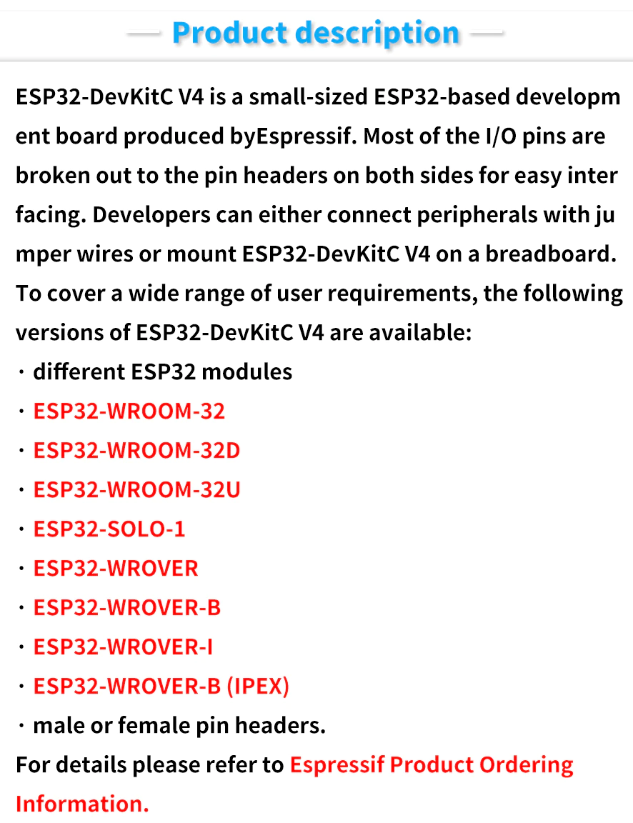
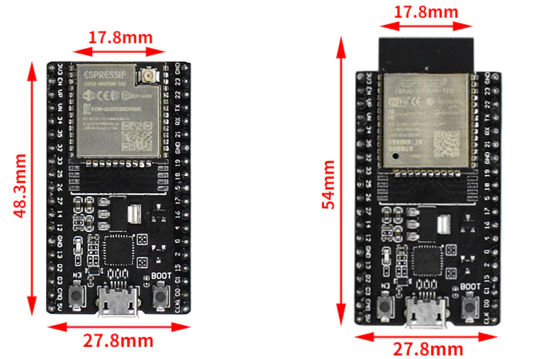
Pool Clock : ESP32-WROOM-32U
ESP32-VROOM-32D
ESP32-VROOM-32U
Getting Started ESP32-DevKitC V4 development board.
API Reference
Demo Code
Pool Clock © Yves Gaignard - 2023

Slide 10
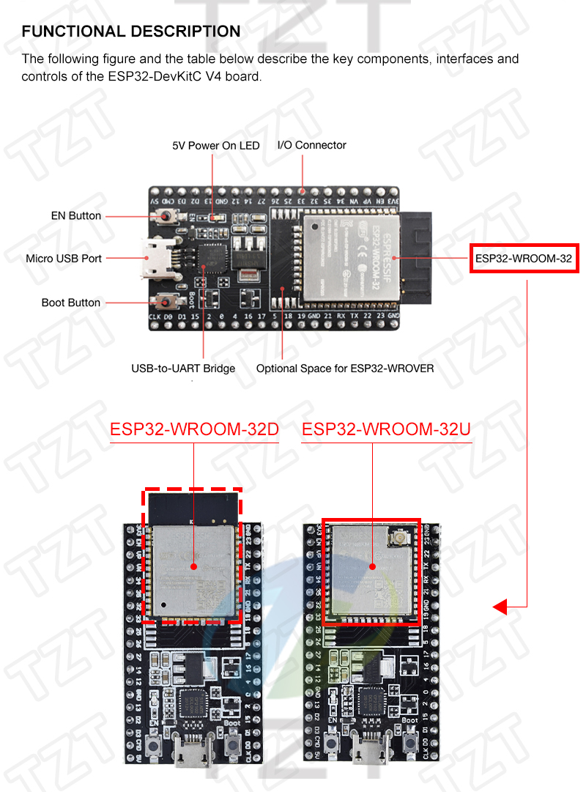
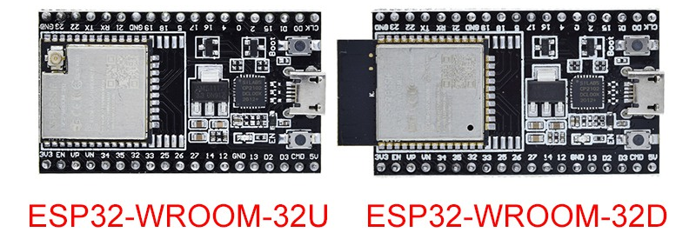
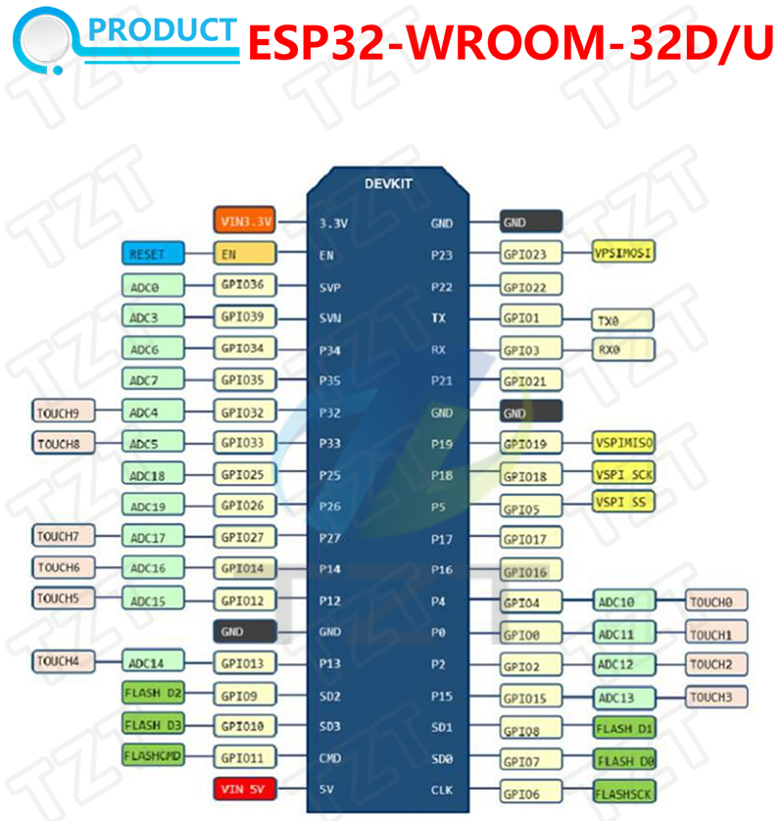
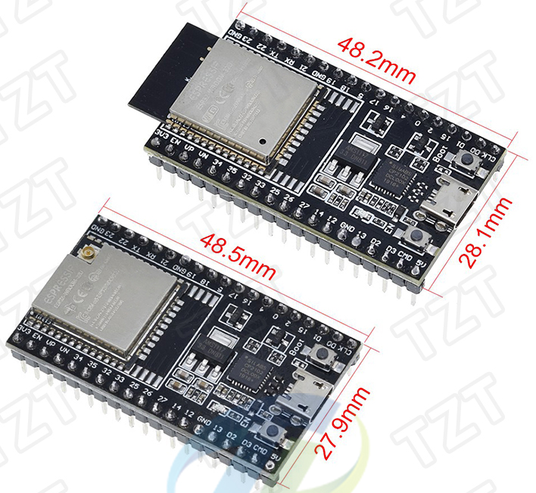
Pool Clock : ESP32-WROOM-32U
Aperçu
ESP32-DevKitC V4 est un petit-taille ESP32-based conseil de développement produit par Espressif. Plus de la I/O pins sont éclaté à les en-têtes broches sur les deux côtés pour un interfaçage aisé. Les développeurs peuvent soit connecter des périphériques avec jumper fils ou montage ESP32-DevKitC V4 sur une planche à pain.
Pour couvrir une large gamme de besoins des utilisateurs, les versions suivantes de ESP32-DevKitC V4 sont disponibles:
Différents ESP32 modules
ESP32-WROOM-32
ESP32-WROOM-32D
ESP32-WROOM-32U
ESP32-SOLO-1
ESP32-WROVER
ESP32-WROVER-B
ESP32-WROVER-I
ESP32-WROVER-B (IPEX)
Mâle ou femelle broches.
Pour plus de détails s'il vous plaît se référer à Espressif Produit Informations De Commande.
Getting Started ESP32-DevKitC V4 development board.
API Reference
Demo Code
Pool Clock © Yves Gaignard - 2023

Slide 11
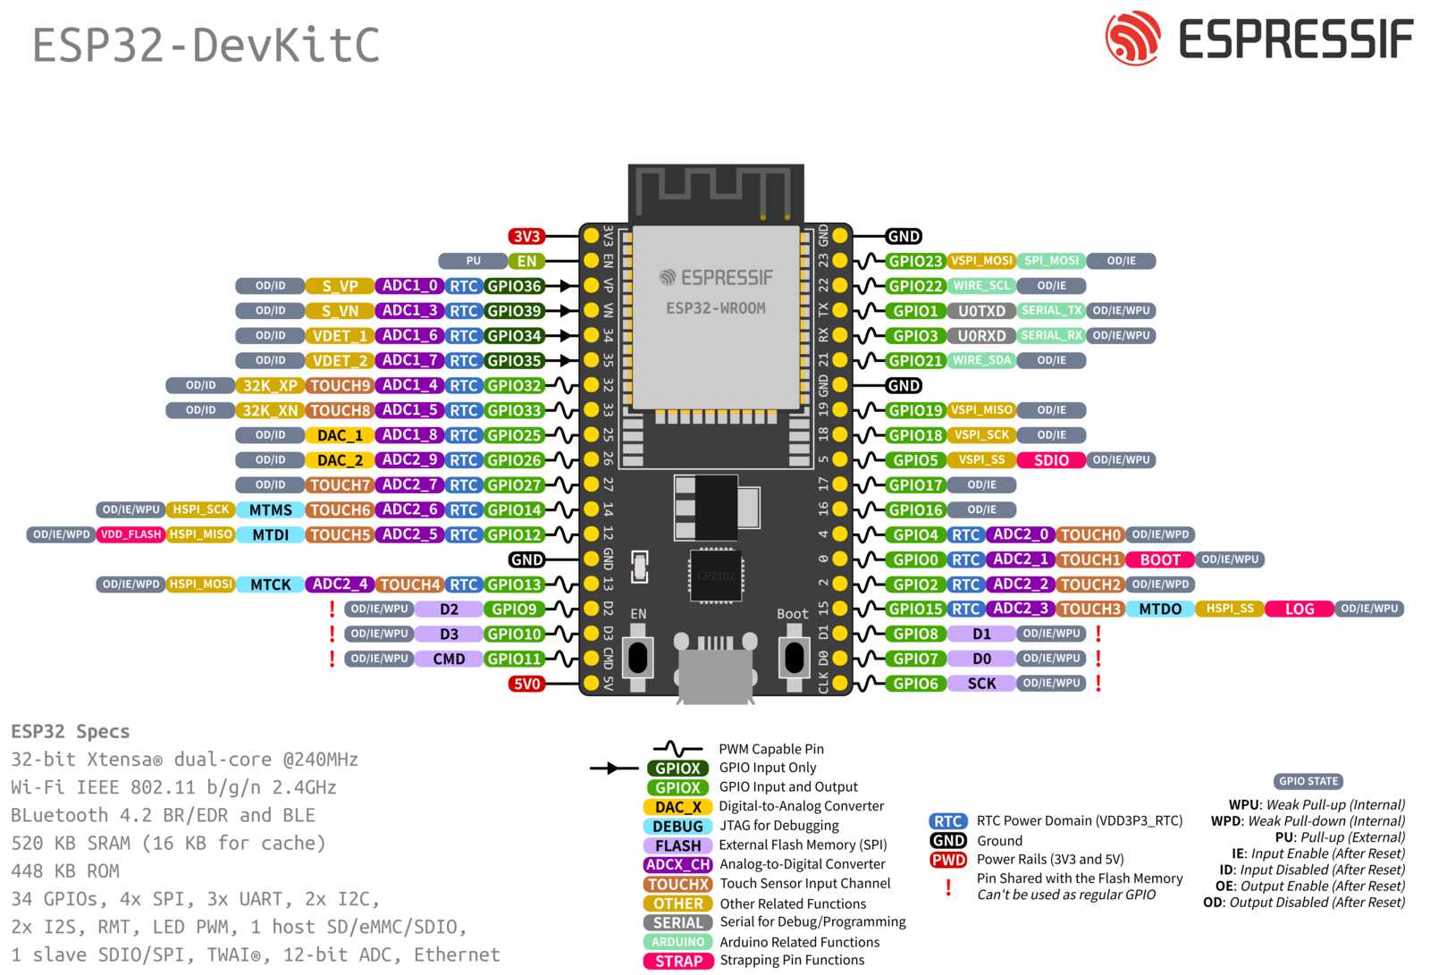
GND
22/SCL-Bus I2C
Light sensor-34
21/SDA-Bus I2C
18-LEDs
B4-Minus-26
05-PIR
B3-Play/Pause-27
17-Buzzer
04-T° Water
B2 Plus-14
B1-Mode-12
5V
Pool Clock © Yves Gaignard - 2023

Slide 12
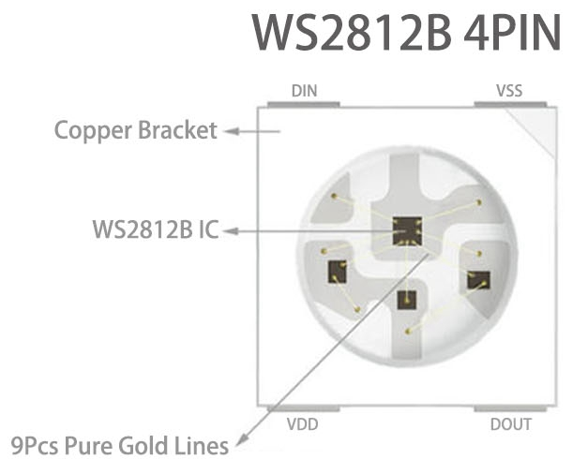
Pool Clock : Led Strip WS2812B 60 Leds/m IP30
Product Description: 1. WS2812B Led Strip is Powered By "5V Power Supply" (Not Included) And Is Controlled By A Single Data Line From A Suitable Controller (Not Included). 2. 3-Pin JST Connector Included: Red: VCC, Withe: GND, Green: DATA. 3. The Strip Has 3M Adhesive Tape On The Back(Except Ip67). Installation Surface Must Be Smooth, Clean And Dry. 4. Led Strip Can Be Cut Between Every Led To Create Custom Lengths. 5. Do Not Bend Strip Sharply. 6. Longer Runs Should Be Powered From Both Ends To Reduce Voltage Drop. 7. 3-Pin JST Connector Wire is 20AWG. Product Details: Input Voltage: DC5V Power: 60Leds/m----12Watt/meter LED Resource: WS2812B Led(5050 SMD RGB LED With Built-in Improved Version Of WS2811 IC) LED: Each Led is Separately Controlled IC Type: Improved Version WS2812 IC(Built Inside The 5050SMD RGB LED) Of IC: 1 IC Drives 1 Led Chip Pixels: 30/60/74/96/144/Meters Pitch: 16.6mm(1000/64) Grey Scale: 256 Bits/Color: 8-Bits/Color FPC Width: 60Leds/m----10mm FPC color: Black/White Protection Rate: IP30/ IP65 /IP67 Colors: Full Color RGB, Dream Color Changing Cut-able: Every LED is Cut-able Package: In Anti-Static Bag,IP30 IP65 With 3M Adhesive Tape On The Back(IP67 Without 3M Adhesive)
Pay Attention (Important: WS2812B Must Work With 5V LED Power Supply. Over DC5.5V will Burn Led Strip)
1. Led strip welded by 0.5m is very normal in an electronic product, not a quality problem. 2. WS2812B Led strip can be cut buy every "one" led chip! 3. IP30: Non- Waterproof, IP65: Waterproof in Silicon Coating, IP67: Waterproof in Silicon Tube 4. WS2812B Led Strip Work With DC5V Led Power Supply. And it must need a WS2812B Led Controller Control it About how to choose Led Power Calculated The Whole Led Strip Watts: 1. One Led Chip is About 0.2W. If You Buy 5m with 30Leds/m (Total Led Strip is 150Leds), So 0.2W*150=30W 2. And This Led Strip Work 5V, so 30W / 5V=6A
Pool Clock © Yves Gaignard - 2023

Slide 13
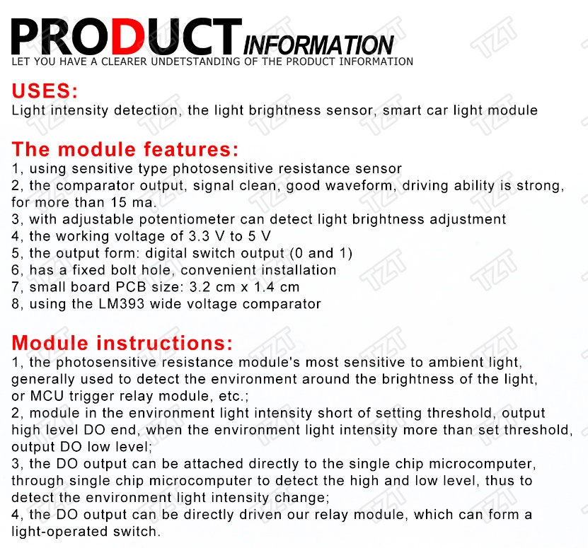
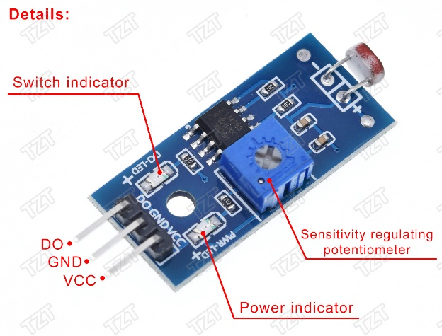
Pool Clock : Photosensitive Sensor Module Light Detection Module
The module features:
1- using sensitive type photosensitive resistance sensor 2- the comparator output, signal clean, good waveform, driving ability is strong, for more than 15 ma. 3- with adjustable potentiometer can detect light brightness adjustment 4- the working voltage of 3.3 V to 5 V 5- the output form: digital switch output (0 and 1) 6- has a fixed bolt hole, convenient installation 7- small board PCB size: 3.2 cm x 1.4 cm 8- using the LM393 wide voltage comparator Module instructions 1- the photosensitive resistance module's most sensitive to ambient light, generally used to detect the environment around the brightness of the light, or MCU trigger relay module, etc.; 2- module in the environment light intensity short of setting threshold, output high level DO end, when the environment light intensity more than set threshold, output DO low level; 3- the DO output can be attached directly to the single chip microcomputer, through single chip microcomputer to detect the high and low level, thus to detect the environment light intensity change; 4- the DO output can be directly driven our relay module, which can form a light-operated switch.
The wiring diagram:
int Led = 13; // define LED interface
int buttonpin = 3; // define the photosensitive resistance sensor interface
int val; // define digital variable val
void setup()
{
PinMode (Led, OUTPUT); // define the LED for the output interface
PinMode (buttonpin, INPUT); // define photosensitive resistance sensor as the input interface
}
void loop()
{
val = digitalRead(buttonpin); // to assign the value of digital interface 3 read val
if (val == LOW) // when the photosensitive resistance sensors have a signal, the LED light
{ DigitalWrite(Led, HIGH); }
else
{ DigitalWrite(Led, LOW); }
}
Pool Clock © Yves Gaignard - 2023

Slide 14

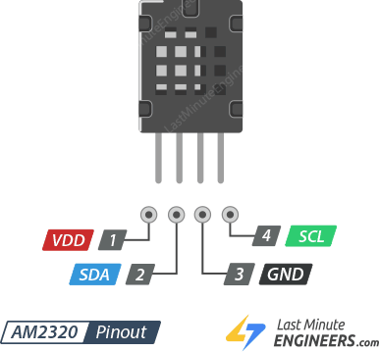
Pool Clock : AM2320 Digital Temperature and Humidity
Product Description
1. AM2320 digital temperature and humidity sensor is a calibrated digital signal output containing hexyl temperature and humidity sensor complex. Temperature and humidity using a dedicated capture technology to ensure that products with high reliability and excellent long-term stability. Sensor includes a capacitive humidity sensing element and an integrated high-precision temperature measurement devices, and connected with a high-performance microprocessors. The product has excellent quality, fast response, anti-interference ability, high cost and other advantages.
2. AM2320 communication using a single bus, standard I2C two means of communication. Standard single-bus interface, allowing system integrators to become simpler and quicker. Ultra-small size, low power consumption, signal transmission distance up to 20 meters or more, making it the best choice for all kinds of applications and even the most demanding applications. I2C communication using standard communication sequence, the user can directly linked to the I2C communication bus without additional wiring, simple to use. Two means of communication are used as humidity, temperature and check CRC and other digital information directly via temperature compensated output, users do not need to calculate the secondary digital output, and no need for temperature compensation of the humidity, you can get an accurate temperature and humidity information.
Product Features
1. Ultra-small size
2. Super cost-effective
3. Ultra-low voltage operation
4. Excellent long-term stability
5. Standard I2C and single-bus output
6. Power supply: DC 3.1~5.5V
Applications
HVAC, dehumidifiers, testing and inspection equipment, consumer goods, automotive, automation, data loggers, weather stations, home appliances, humidity control, medical, and other relevant humidity measurement and control.
Pin Definitions
1. VDD: Power supply (3.1V~5.5V). Since the sensor uses 3.1 to 5.5VDC, give it the same power as the logic level of your microcontroller – e.g. for a 5V micro like Arduino, use 5V.
2. SDA: Serial data, bi-directional port, requires a pullup of 2.2K – 10K to VDD.
3. GND: Ground
4. SCL: Serial clock, input port, requires a pullup of 2.2K – 10K to VDD.
Pool Clock © Yves Gaignard - 2023

Slide 15
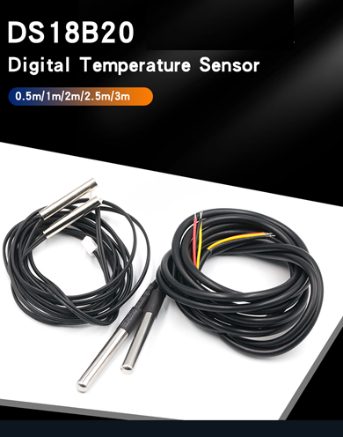
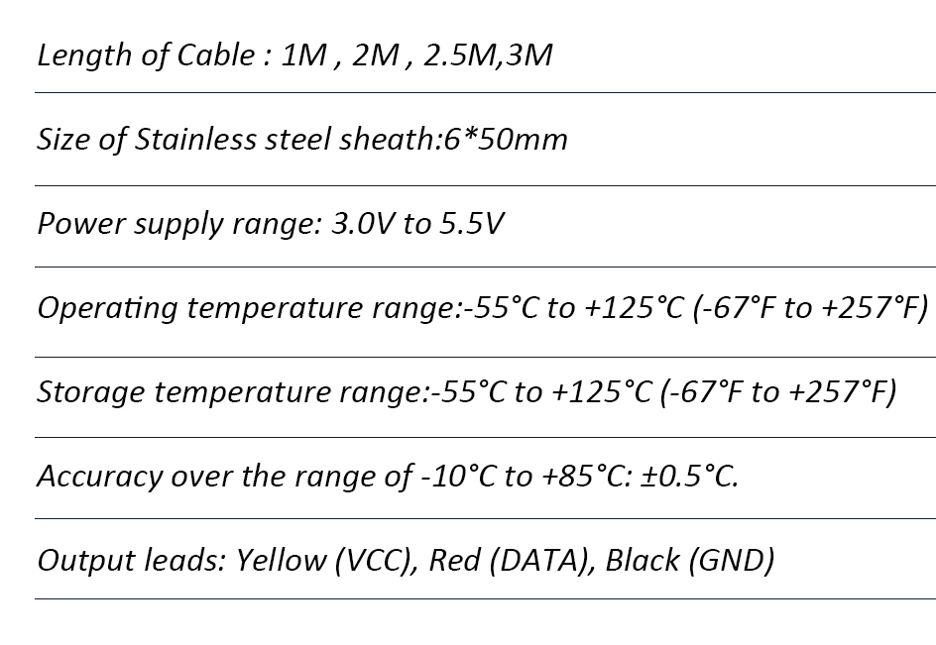
Pool Clock : DS18B20 Waterproof Temperature Sensor
DS18B20
Pool Clock © Yves Gaignard - 2023

Slide 16
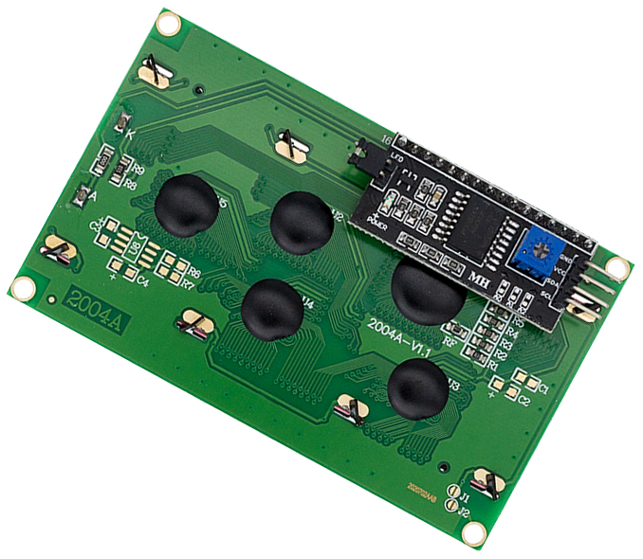
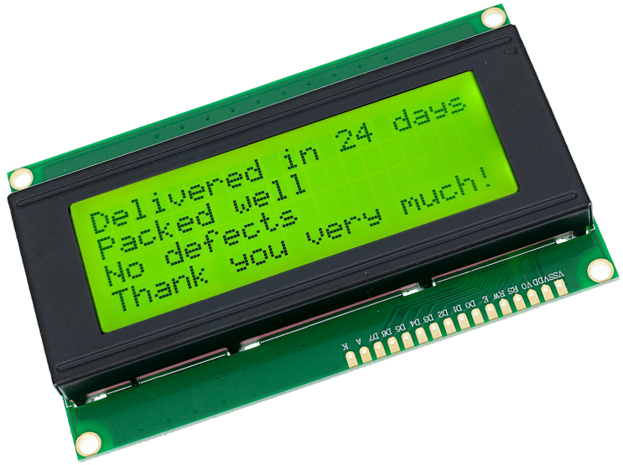
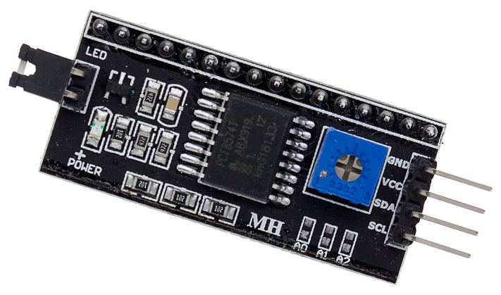
Pool Clock : LCD 20x4 I2C
LCD 20x4
Product Features
Displays 4-lines X 20-characters
Operate with 5V DC. You can connect directly to arduino board
Size : 60mm×99mm
Pin Definition : GND.VCC.SDA.SCL
Arduino IIC/I2C interface was developed to reduce the IO port usage on Arduino board
Pool Clock © Yves Gaignard - 2023

Slide 17
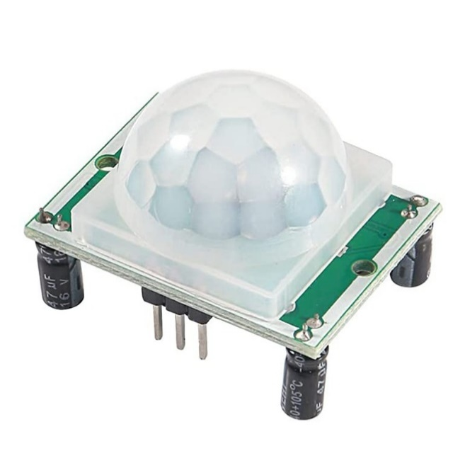
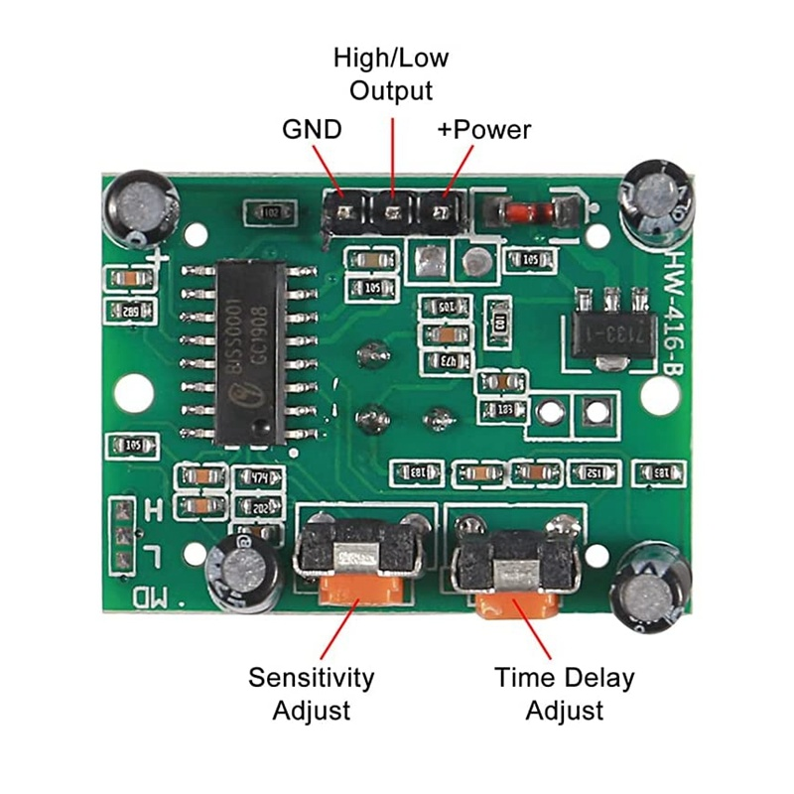
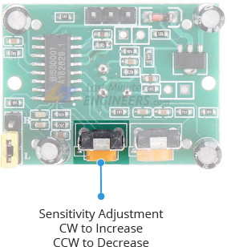
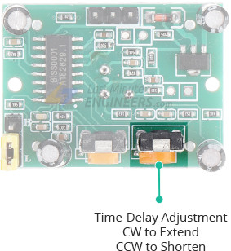
Pool Clock : HC SR501 PIR Motion Sensor
HC-SR501 PIR Sensor
HC SR501 PIR Infrared Sensor IR Human Body Motion Module for Arduino
Specifications:
Operating voltage range: DC 4.5-20V
Angle Sensor: ﹤100°cone angle Lens size
Level Output: High 3.3V / Low 0V
Sensor Diameter: 23mm(Default)
Operation Temp: -15°C to +70°C
Application:
It can automatically and quickly open various types of incandescent, fluorescent lamps, buzzer, automatic doors, electric fans, automatic washing machine and dryer machines and other devices, is a high tech products.
Especially suitable for enterprises, hotels, shopping malls, warehouses and family aisles, corridors and other sensitive Sense of region, or for the security zone automatic lighting, lighting and alarm systems.
Pool Clock © Yves Gaignard - 2023

Slide 18
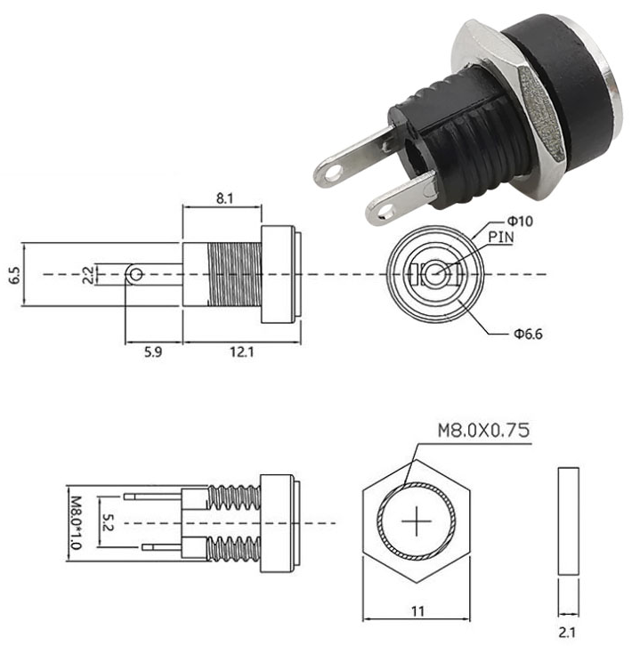
Pool Clock : Female Power Connector 5.5 x 2.1mm
Female Power Connector 5.5 x 2.1mm
Pool Clock © Yves Gaignard - 2023

Slide 19
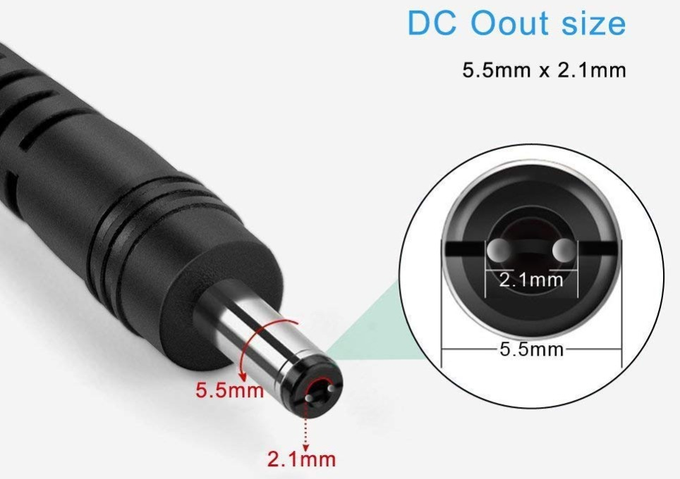
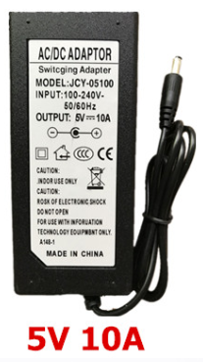
Pool Clock : LED Power Adapter 5.5*2.1~2.5mm Female Connector AC 220V To DC 5V (10A)
Specifications:
Input Voltage: AC 110~220V
Output Voltage: DC 5V
Max Load Current: 10A
Max Load Power: 24W 48W 72W 120W 144W 192W 240W
Frequency: 50/60Hz DC Plug
Outer Diameter: 5.5mm Inner Diameter: 2.1~2.5mm
Working Temperature: -20~40 Celsius degree
Storage Temperature: -20~60 Celsius degree Safety
Compliance: Built-in over voltage, over current, and short circuit protection
Pool Clock © Yves Gaignard - 2023

Slide 20
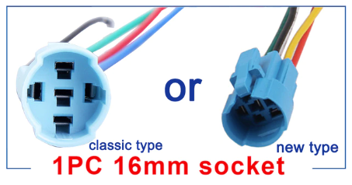
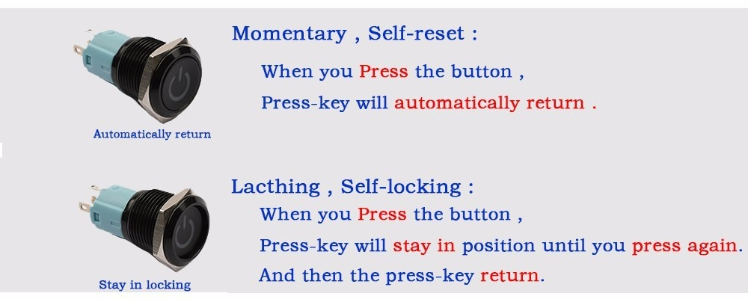
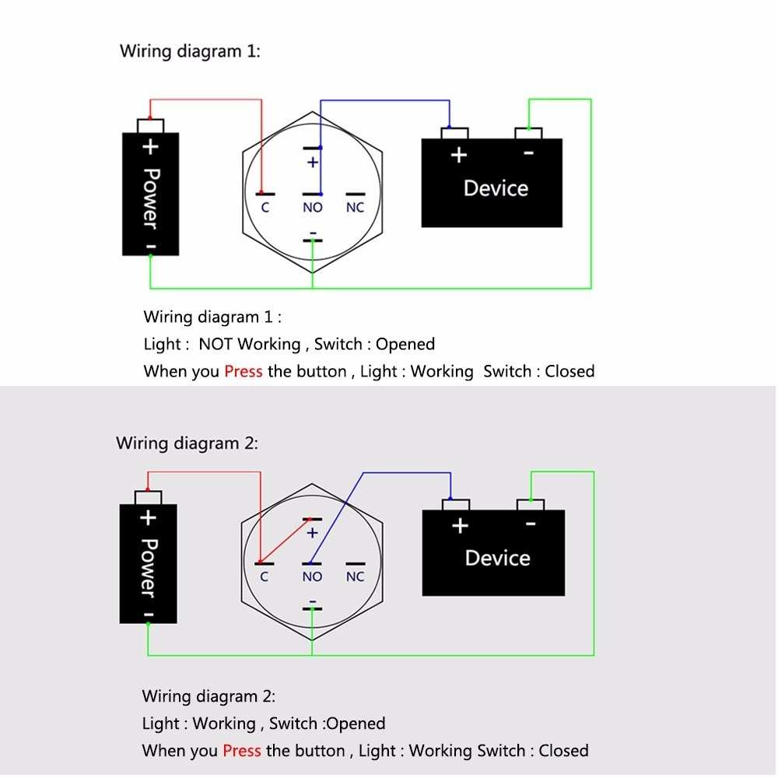
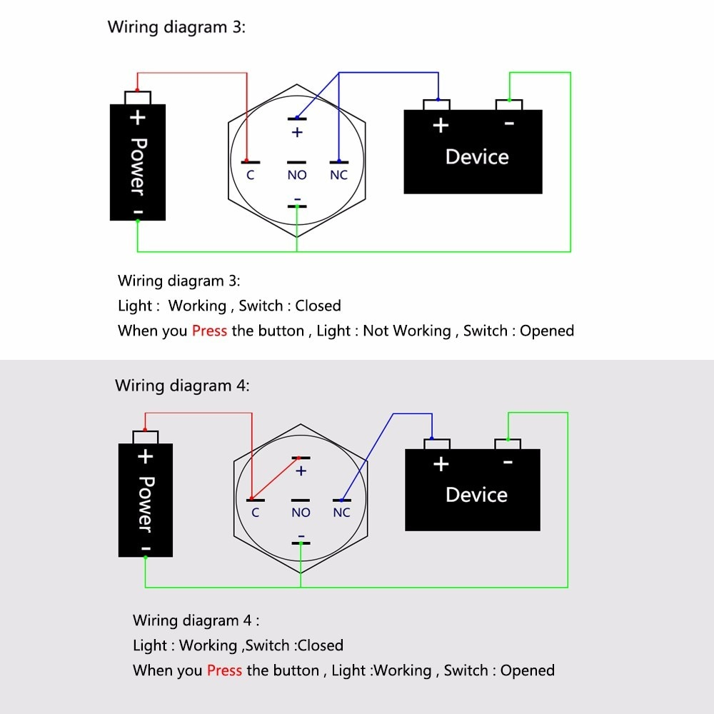
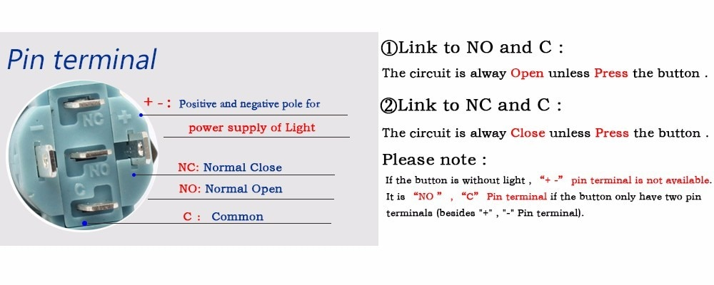
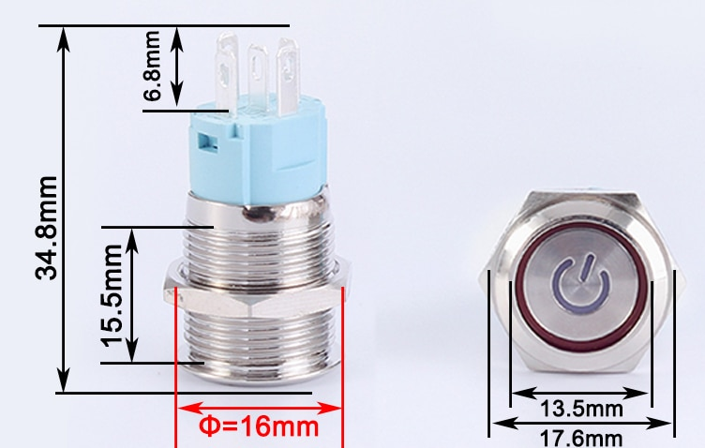
Pool Clock : Push Button
Push Button
Pool Clock © Yves Gaignard - 2023

Slide 21
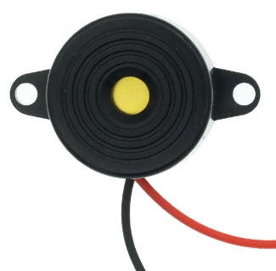
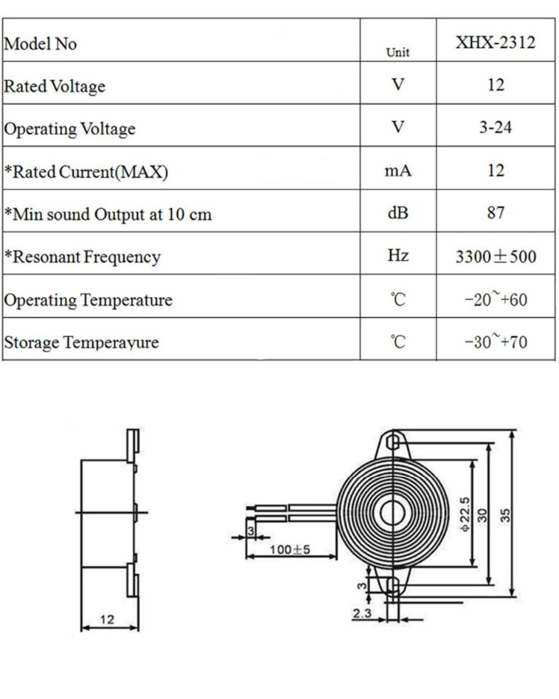
Pool Clock : Piezo Electronic Buzzer
Piezo Electronic Buzzer
Description:
Color: Black Alarm Diameter:22mm/0.86" Alarm Height:10mm/0.39” 2 Mounting Holes distance:30mm/1.18" 2 Wires length:90mm/3.54" Buzzer Type: Piezoelectric Sound Pressure Level 95 dB Rate Voltage: 12V DC Operating Voltage: 3 - 24V Max Current Rating 10mA Frequency 3900±500Hz Drive Method: Drive Circuit Built in Mounting Holes Sound: "Di" Continuous Package includes: 1 x 95DB Piezoelectric Buzzer Alarm
Pool Clock © Yves Gaignard - 2023

Slide 22



Pool Clock : Led Wiring Schema
Display
Display
Display
Display
Display
Display
Display
Display
Display
0
1
2
3
4
5
6
7
8
7 segments
2 segments
7 segments
7 segments
7 segments
1 Led per segment
3 Leds per segment
7 Leds per segment
7 Leds per segment
3 Leds per segment
Pool Clock © Yves Gaignard - 2023

Slide 23
Pool Clock : Segment Directions and Positions
7 segments
2 segments
1
0
2
0 : TOP_LEFT_SEGMENT
1 : TOP_MIDDLE_SEGMENT
2 : TOP_RIGHT_SEGMENT
3 : CENTER_SEGMENT
4 : BOTTOM_LEFT_SEGMENT
5 : BOTTOM_MIDDLE_SEGMENT
6 : BOTTOM_RIGHT_SEGMENT
0
0 : TOP_LEFT_SEGMENT
4 : BOTTOM_LEFT_SEGMENT
3
4
6
4
5
Pool Clock © Yves Gaignard - 2023

Slide 24
Pool Clock : Use
Once the initialization is done, Pool clock displays both the time on the central part, air and water temperature on the lateral displays.
If the Mode button is pressed, the Timer is displayed with the latest timer value.
If the Mode button is pressed again, the Current Time is displayed.
But if the Mode button is long pressed (>2 sec), the Timer Setting screen is displayed.
Setting the timer is done by pressing:
Play button to select alternatively the hour or minute digits. The blinking digit indicates which digits can be modified.
Plus button increase the hour or minute blinking digit
Minus button decrease the hour or minute blinking digit
A long press of Play button validates the chosen Timer value.
A long press of Mode button cancel the Timer setting and go back to the current time display.
When the Timer is enabled, the central part displays the remaining time. When the set time is reached, the alarm sounds and the timer display is blinking.
To start the timer, press the Play button.
If it is pressed again, the timer is paused. If it is pressed again, the timer is resumed.
If the Mode button is long pressed, the timer is canceled and the central display goes back to the current time.
Pool Clock © Yves Gaignard - 2023

Slide 25
Pool Clock : Command State Machine
State | Input Buttons
 | Mode | Long Mode | Play | Long Play | Plus | Long Plus | Minus | Long Minus
0:Clock | 1 / CMTR | 2 / CMSTR | 0 / NOP | 0 / NOP | 0 / NOP | 0 / NOP | 0 / NOP | 0 / NOP
1:Timer | 0 / CMC | 2 / CMSTR | 1 / SPR | 1 / SPR | 1 / NOP | 1 / NOP | 1 / NOP | 1 / NOP
2:Set Timer | 2 / NOP | 0 / CSTR | 2 / MNDG | 1 / VSTR | 2 / INCDG | 2 / INCQDG | 2 / DECDG | 2 / DECQDG
Play, Long Play / SPR
Plus, Long Plus, Minus, Long Minus / NOPE
Outputs
NOPE : Null Operation
CMTR: Change Mode To Timer
CMSTR: Change Mode To Set Timer
CMC: Change Mode To Clock
SPR : Start / Pause / Resume Timer
CSTR: Cancel Set Timer
VSTR: Validate Set Timer
MNDG: Move Next Digit
INCDG : Increment Digit
INCQDG : Increment Quickly Digit
DECDG : Decrement Digit
DECQDG : Decrement Quickly Digit
1: Timer
Mode/CMC
Long Play/VSTR
Play, Long Play,
Plus, Long Plus,
Minus, Long Minus
/ NOPE
Mode/CMTR
Long Mode/CMSTR
0: Clock
2: Set Timer
Long Mode/CMSTR
Mode / NOPE
Play / MNDG
Plus / INCDG
Long Mode/CSTR
Long Plus / INCQDG
Minus / DECDG
Pool Clock © Yves Gaignard - 2023
Long Minus / DECQDG

Slide 26


Pool Clock : Icons
Indoor Air Temperature
Pool Water Temperature

Slide 27
Pool Clock : Command State Machine
M
CHG STATE
M
M
CHG STATE
CHG STATE
>
>
CLOCK
TIMER
START/PAUSE/RESUME
SET_TIMER
M
>
CHG STATE
OK + CHG STATE
>
M
NEXT DIGIT
Buttons
Short Press
Long Press
CANCEL + CHG STATE
Mode
M
M
Transition
> / ||
>
>
States
+
+
+
-
-
+
+
Actions
-
DIGIT +
DIGIT -
-
-
Pool Clock © Yves Gaignard - 2023

Slide 28

Pool Clock : Wiring Diagram
Pool Clock © Yves Gaignard - 2023

